Slide 1
AtliQ Sales and CRM Assistant
AtliQ doesn't lack leads. It lacks memory.
Capstone 1 · Ashokkumar, AI Product Manager · Data as of 10 July 2026
Notes:
AtliQ's four sellers are losing deals they are already winning, not because of fit or price, but because nobody remembers what was promised. Sales and CRM Assistant is an AI assistant that keeps that memory for them, with a human approving anything that changes a record or reaches a client.

Slide 2
Revenue is leaking from deals AtliQ is already winning
$442.5k
41%
0 / 40
20 days
valued pipeline across 8 deals waiting on a missed or at-risk AtliQ action
of client asks and AtliQ promises actioned on time (15 of 37, Jun to Jul)
CRM records with a next follow-up date
median wait on the 21 asks and promises already past due
FinEdge ($95k) waited 21 days for a call-slot confirmation. Meridian's ($45k) proposal questions waited 24 days. ClearPath's unfrozen 40k budget got no reply for 31 days.
Source: PRD Appendix A, hand-labelled from the AtliQ dataset (34 email threads, 16 meeting notes, 40-record CRM export).
Notes:
These numbers come from hand-labelling every ask and promise in the dataset. The pattern is consistent: the deals are real, the clients are engaged, and AtliQ goes quiet.

Slide 3
Discovery: sellers work from a phone, not the CRM
Primary persona
“We find out what's urgent by accident.”
Bhavin, co-founder and lead seller
Karandeep, CEO
Owns the four largest open deals: FinEdge $95k, NovaPharma $80k, ShopSwift $55k, Meridian $45k.
Sells between meetings and on the road while running the company.
Goal: close what's in play on time and turn referrals into revenue.
“I answer emails on my phone between meetings and it never gets into the system.”
Karandeep, CEO
“Can you put this in the CRM? I'll forget half of it by next week.”
Dhaval, co-founder
“Biggest deal we have and it's been sitting three weeks.”
Bhavin, on FinEdge
Notes:
Discovery used the dataset's emails and meeting notes as the interview record. The same behaviour shows up for all four sellers: promises made on a phone, CRM updated later or never, and priorities argued from memory in meetings.

Slide 4
Five whys lead to one root cause: no shared working memory
1
2
3
4
5
Deals slip
No one sees what's owed
Capture is a chore
No payoff in the moment
Passive system
Client asks and AtliQ's own promises are missed.
Deadlines live in personal inboxes and scribbles.
CRM entry is a separate step, done later at a laptop.
'Update the CRM same-day' failed in April and in July.
The CRM is a database that depends on discipline.
Root cause
Nothing turns the conversations where selling happens (emails, calls, meetings) into structured, owned, dated next actions. The fix has to do the capture for the sellers, not ask more of them.
Notes:
Each why is backed by the dataset. The key insight for the product: the 'update same-day' rule already failed twice, so any solution that relies on more seller discipline will fail a third time.

Slide 5
The gap shows up account by account
Account | What the client said | What happened | Days waiting
FinEdge ($95k) | Compliance cleared; please confirm your availability for the commercial call | No reply | 21
Meridian ($45k) | Two proposal questions before our mid-July budget review | Unanswered; deal also entered twice in the CRM | 24
ClearPath ($40k) | Budget unfrozen: “does the 40k estimate still hold?” | No reply; CRM still says Lost | 31
Zenlytics | Bhavin: “I'll send a calendar invite shortly” | Never sent | 35
Trustline ($48k) | Board approved; please send the revised contract | CRM still says Proposal Sent | -
Harbor & Finch | Referral from FinEdge: “Do you have time in the next couple of weeks?” | No reply; company not in the CRM | 13
Days waiting as of 10 July 2026. Five warm leads never reached the CRM: Harbor & Finch, Nimbus Lending, PixelWorks, Lumino Fitness, Ridgeline Foods.
Notes:
Pick any account and compare the CRM with the inbox: the gaps are the story. These six are the clearest examples and every one maps to a feature in the solution.

Slide 6
We scored 15 AI opportunities and built the top six
Built: the six Do-first ideas
Folded into four MVP features. The review pack and reply drafts came along cheaply because they reuse the same ledger.
Parked on purpose
Auto-send, auto-written SOWs and pricing, auto-answered security questionnaires, lead scoring and web enrichment: too costly to get wrong, or no data to do it well.
Notes:
Impact combined revenue at risk, frequency and evidence strength. Feasibility combined data availability, technique maturity, cost of being wrong and build effort. The parked list became the product's 'should not' list.

Slide 7
Four features, one rule: propose, never act alone
F1
F2
F3
F4
Capture & Link
Commitment Ledger
Daily Brief
Propose
Links every email and note to the right CRM account; flags duplicates; drafts leads for unseen companies.
Pulls out asks, promises, deadlines, referrals and revisit signals, each with a verbatim quote.
Ranks what each seller owes today, capped at 10, plus a pipeline review pack.
Suggests CRM updates and reply drafts with blanks for unknown facts.
Rules first, then GPT-OSS 20B
GPT-OSS 120B
Ranking in code; GPT-OSS 120B one-liners
GPT-OSS 120B
The seller decides. Approve, edit or reject in one tap. Approved CRM changes are written and logged with who and when. Sales and CRM Assistant has no permission to send anything to a client.
Notes:
Sales and CRM Assistant sits on top of the existing CRM, inboxes and meeting notes. It does the capture and recall work; people keep every decision that changes a record or touches a client. The models are open-weight GPT-OSS models on Groq, the stack the live prototype runs on; Claude stays in the code as a fallback.

Slide 8
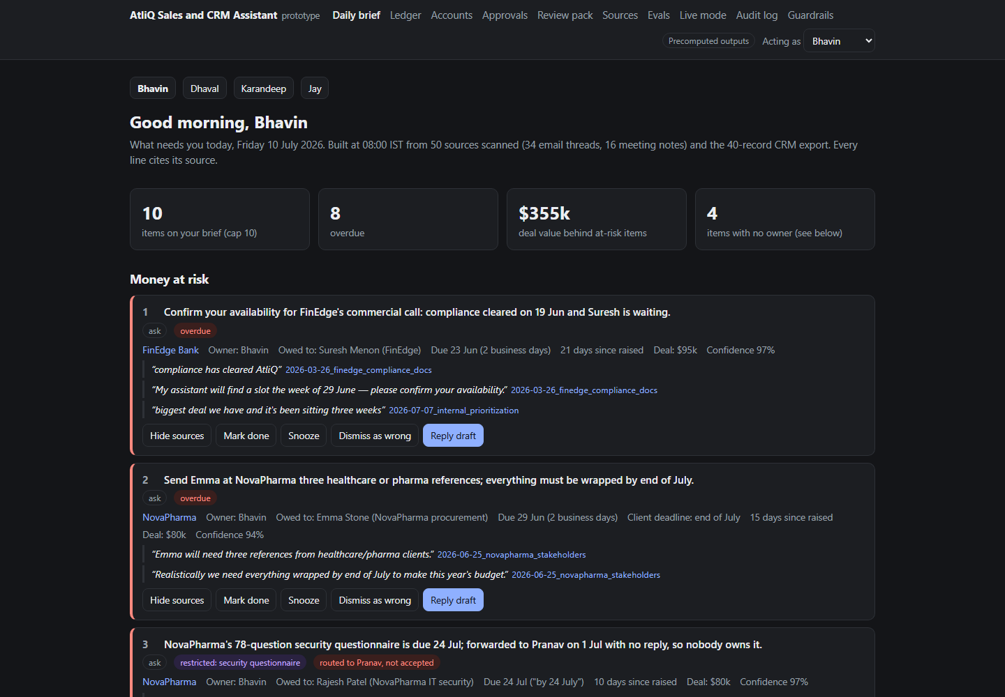
8:00 am: Bhavin sees what needs him, ranked and cited
1
Money at risk first
FinEdge, NovaPharma, ShopSwift and Meridian, $275k between them, lead the list.
2
Every line cites its source
The exact quote and the file it came from, one click away.
3
Short by design
Capped at 10 items, with done, snooze and dismiss.
4
Reply draft in one tap
Copy only. Sales and CRM Assistant never sends.
Notes:
This is the live prototype at atliq-sales-and-crm-assistant.vercel.app. The ranking rule is plain code and is shown on the page, so a seller can see why an item is where it is.

Slide 9
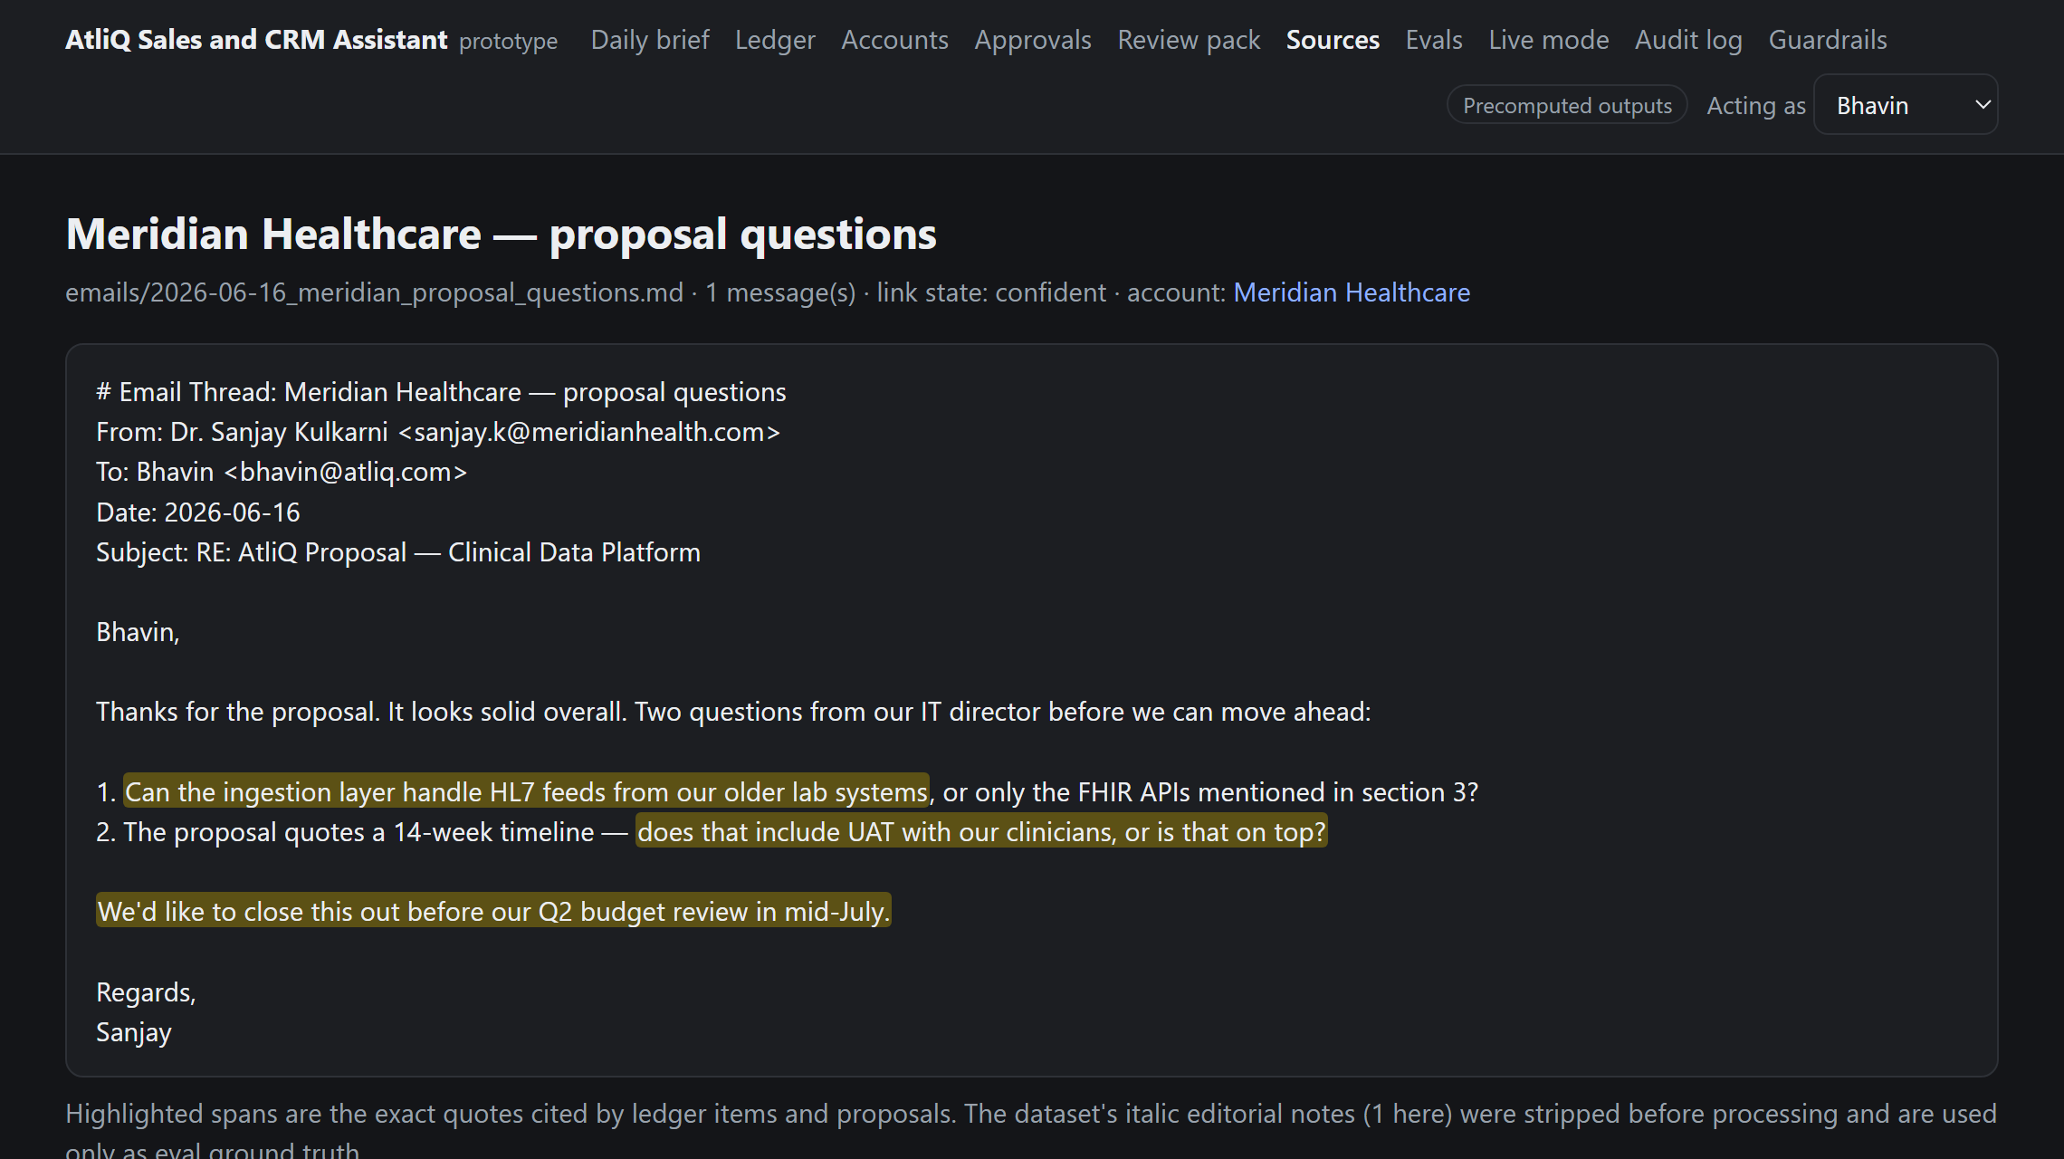
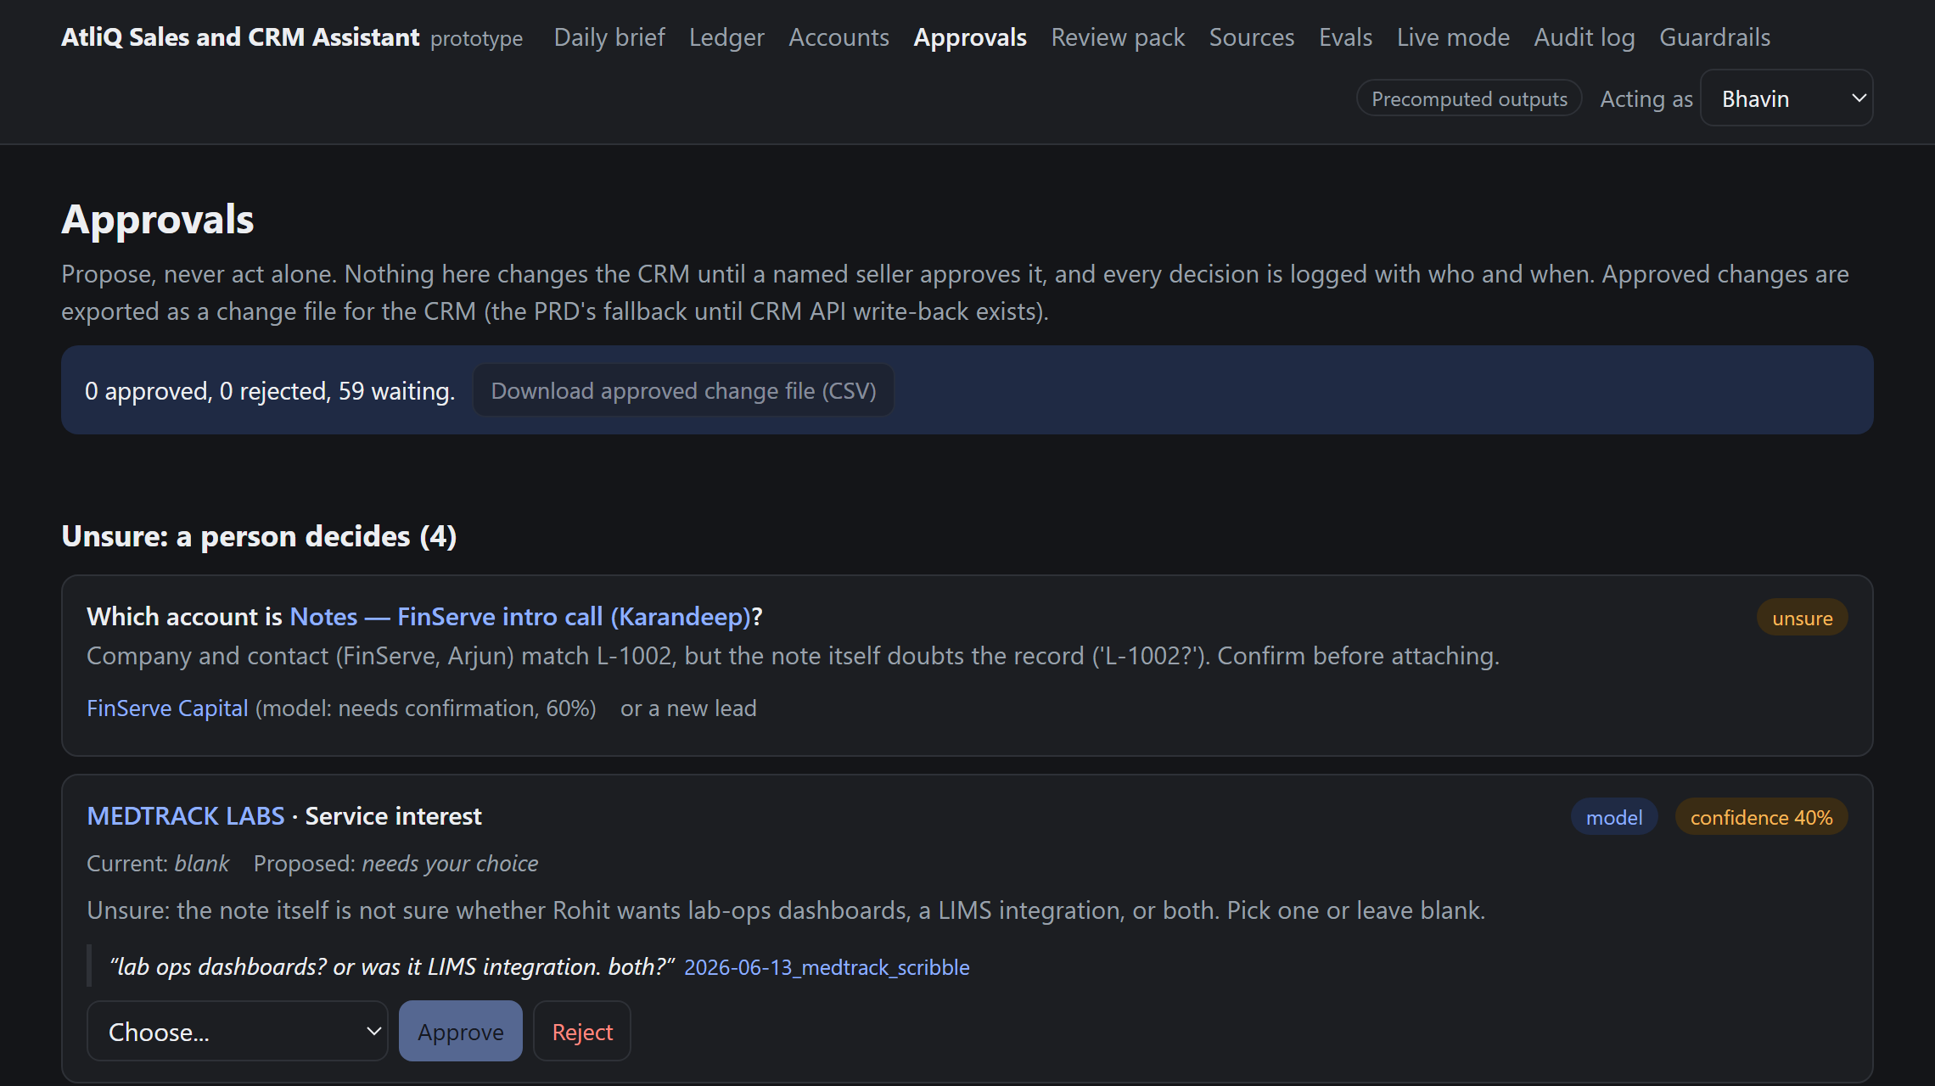
Grounded in sources, gated by people
Grounded. Quotes are highlighted in the original email. An item whose quote isn't in the source is dropped.
Human in control. Duplicates (Meridian), unsure names and new leads go to a person with the evidence. Nothing merges or writes on its own.
Notes:
Left: Meridian's email with the cited spans highlighted. Right: the approvals queue, where the Meridian duplicate, the uncertain FinServe link and the MedTrack service interest wait for a decision.

Slide 10
Rules where possible, models where needed
Pre-process
Strip signatures and editorial notes
Code
$12 per seller per month
About $47 a month for four sellers: under $2 of Groq inference, $45 for Vercel Pro and Supabase Pro. Doing the same capture by hand would take about $457 a month of coordinator time.
Link
Email, domain, lead_id, company
Code + 20B
Extract
Fixed schema, verbatim quotes
GPT-OSS 120B
Validate
Drop any item whose quote isn't found
Code
Prototype stack
Next.js on Vercel's free tier, no paid database
Precomputed, quote-checked outputs for the demo
Live models on Groq; Claude kept as a fallback
Rank
Owner, due date, overdue, brief order
Code
Propose
CRM updates and reply drafts
GPT-OSS 120B
Notes:
Cost shaped the design: the smaller GPT-OSS 20B model gates every message and the 120B model only sees messages that carry a commitment, plus everything a seller reads. Ranking, due dates and duplicate checks are code, which removes calls and makes the brief explainable. Moving from the original Claude plan to Groq cut inference from about $16 to under $2 a month; hosting is now most of the cost. Figures are from the updated Step 4 cost estimate (4 Oct 2026). Open point: Groq processes data in the US, which we must resolve for clients with in-country rules before using real client data.

Slide 11
North Star: Commitments Kept on Time, from 41% to 90%
Supporting metrics: today and target
Pipeline completeness
0 of 31 open deals → 100% with owner, next step, follow-up date
Responsiveness
20-day median wait → 2 business days or less
Pre-review reconciliation
~2 hours → 15 minutes or less
Trust
70%+ proposals approved, under 20% dismissed
Quality
Recall 90%+, precision 85%+
Guardrails
0 unapproved sends, writes or invented facts
Notes:
A holding reply does not count as actioned, and the North Star is always read next to extraction recall, so it can't rise by capturing less. Any guardrail breach pauses rollout whatever the North Star says. Why not revenue as the North Star: it lags by weeks or months and moves with price, market and deal size, so a two-week beta couldn't show whether Sales and CRM Assistant caused a change. The next slide shows how we still measure revenue.

Slide 12
The North Star leads; revenue follows
Lagging: revenue outcomes it should drive
Leading: the product controls it
Commitments Kept on Time
Win rate: kept vs slipped deals
Deals where every commitment was kept vs deals where one slipped.
Baseline in beta. Today: 5 of 9 closed deals won (56%).
Moves daily. Measures the exact failure we found: deals lost to forgotten follow-ups.
41% today, 80% to leave rollout, 90% by end of Q4.
If kept deals don't win more often within two quarters, we revisit the lever.
Stage conversion
Share of deals moving Proposal Sent to Won, per quarter.
Baseline in beta (no stage history yet). $263k at Proposal Sent today.
Days in stage
Median days a deal waits at each stage.
Proxy: 79 days at Proposal Sent since last CRM contact. Target under 30.
Pipeline behind a missed action
Valued pipeline waiting on an overdue or at-risk AtliQ step.
$442.5k across 8 deals today; target under $50k.
Counter-metric: share of dated next steps that slip again (8 of 9 AtliQ promises slipped in June). Target under 10%, so nobody games the score by postponing.
Notes:
We keep Commitments Kept on Time as the North Star because the product drives it directly and it moves fast enough to steer a two-week beta. Revenue is the outcome it should drive, so we track it underneath. The key test is win rate on deals where every commitment was kept against deals where one slipped: if that gap doesn't appear within two quarters, we revisit whether commitments are the right lever. Stage conversion and days in stage can't be baselined from today's CRM because it keeps no stage history; Sales and CRM Assistant's logged status approvals create that history in beta. The counter-metric stops the score being gamed by turning missed promises into new dated promises.

Slide 13
The prototype already passes the launch evals on the dataset
4 of 4
must-have deals in Bhavin's top five: FinEdge, NovaPharma, ShopSwift, Meridian
The build is the gate
Deployment fails if any shown item lacks a verified quote, or any draft names another client or states an amount not in that client's own records.
Notes:
Thresholds are the PRD's: 95% link accuracy, 90% recall, 100% citation faithfulness, 90% date accuracy, zero draft defects. Measured only from what the sources show, the North Star baseline is 33%, a little below the hand-labelled 41%, because the editorial notes are stripped. The one date miss is LoopMart, dated from the TechSummit debrief.

Slide 14
The highest risks, and the guardrail for each
A message or CRM change without approval
No send permission at all. CRM writes only through one-tap approval, logged with who and when.
An invented price or date in a draft
Unknown facts become [blank]. A safety check withholds drafts with unsupported amounts. In live testing it caught a draft confirming a $40k estimate.
Two clients' facts mixed up
Confidence threshold with an Unsure queue; never auto-merge; drafts see one account's records only.
AI answers a restricted request
SOWs, pricing, contracts and security questionnaires are routed to a person with a due date, never drafted.
The brief gets ignored like the CRM
Capped at 10, ranked by money at risk, with snooze and a tracked dismiss rate.
Kill switch: any unapproved send or write, any cross-client leak, or any invented fact in an approved output pauses rollout immediately.
Notes:
These map to the opportunity map's 'should not' list. The draft-safety check is not theoretical: during live testing it caught a model draft that confirmed ClearPath's 40k estimate, which the PRD forbids.

Slide 15
Rollout earns trust in stages
31 Jul
3 to 14 Aug
17 Aug to 11 Sep
28 Sep
Alpha on the dataset
Closed beta: Bhavin
All four sellers
Full release
Gate: every eval passes
Read-only shadow mode. Gate: recall 90%+, precision 85%+, 0 breaches
Approved CRM writes on. Gate: North Star 80%+ two weeks running
Plus routed tasks for Pranav and Ayush
Done: live prototype
Next after MVP: voice or text quick capture from a phone after a call, the most-requested gap (“by the time I'm at a laptop it's gone”).
Notes:
Each stage has a gate. Stage 1 is complete: the prototype runs over the dataset and passes the evals. Beta runs in shadow mode so nothing is written while we measure recall on real mail.

Slide 16
Next: closed beta with Bhavin, 3 Aug
Approve read-only mailbox access for one seller
Two weeks in shadow mode: nothing is written or sent
Decide on rollout with the eval and North Star data
Try it: atliq-sales-and-crm-assistant.vercel.app
Notes:
The ask is small and reversible: one seller, read-only, two weeks. The data from that beta decides whether we turn on approved CRM writes for all four sellers.

